Slide 1

NextGen Tech
Your vision, our tech, smart solutions
Kelebogile Gopane
23 November 2025

Slide 2
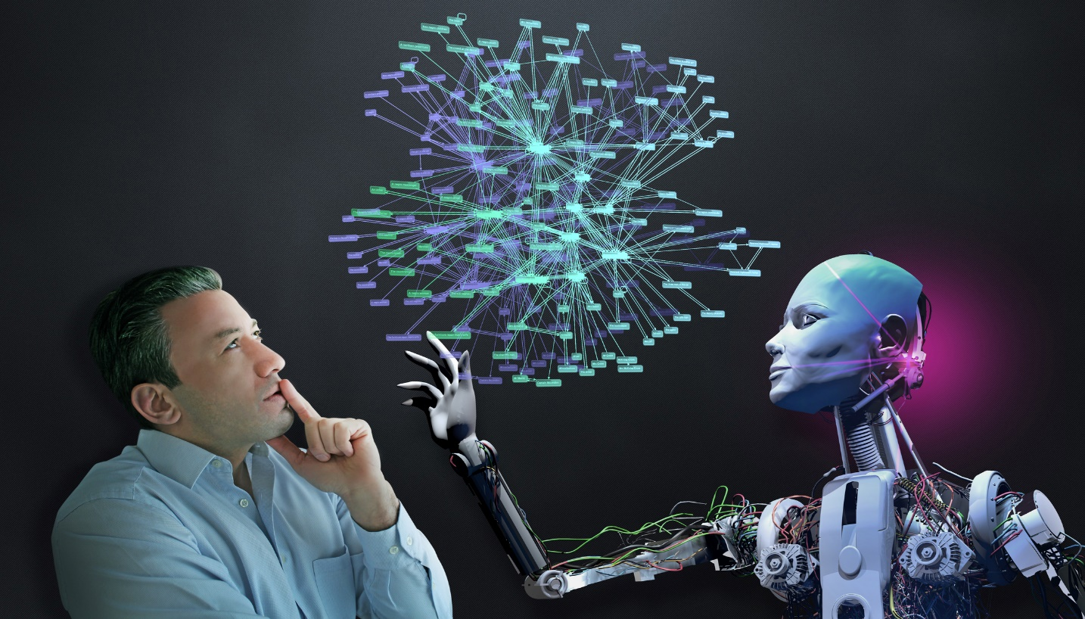
The presentation is going to show you how NextGen Tech work to solve real world problem for people who are every passionate about how technology works and understand its purpose in the current generation and economy we live in.
This presentation will cover:
The main point of computer and coding literacy existence – Why it matters.
The solution we have applied to solve the problem.
Our branding identity.
Channels we will use for marketing.

Slide 3

The Challenge We Are Solving
We as NextGen Tech have realized that most people in this generation, do not have that much understanding about using computers and applying coding skills to design their own website, apps, etc..
That contributes to the increased percentage of about 66% in Africa’s population that are computer illiterate or those who clearly do not know which steps or programming languages they should use to complete their daily task.
Considering the future, we noticed that our economy started to slowly depend on technology. We see how most of the companies hire people who are computer literate people and in tech companies, they now hire people how have experience in designing, developing and protecting systems and that is the kind of future we want to secure for next generation.

Slide 4
From Issue to Impact: Our Approach
We give the future developers and programmers the opportunity to get funding.
They will learn more about how technology operates and how they will get themselves a few steps ahead to be as technology continues to evolve within 2 years.
What sets us apart :
We have built AI systems that prioritizes the updates of newly designed softwares in real time and that enable us to use them once they are released.
We challenge our young developers and programmers to design what they think will be very helpful to our society.

Slide 5
Brand Identity
This company as a SaaS (Software as a Service) startup, Next Gen Tech provides an AI system that caters for every worker’s qualities to work together in one project. Which makes the teams and project’s progress 10x faster than any other tools.
Most of our uploaded projects and designs will be easily accessible and available in the internet with any search engine such as..
Google Chrome
Safari
FireFox
Microsoft Edge
And many more..
Our objective is to make sure that our work is compatible to be used with every operating systems and versions. Of which we test them first before releasing them to the public or world. This guarantees us that no customer or user will experience any troubleshoots while using our tools.
NGT
Next Gen Tech
Your Vision, Our Tech, Smart Solutions

Slide 6
Channels used for Marketing
Along the process of launching this tech company, our plan to place this company among the other best companies in the world. We want to advertise the company and our work through the following platforms:
Facebook
Instagram
Twitter
YouTube
With those mentioned platforms above, this enables us to give our customers a step by step guide on how to use our products especially for the beginners and for those who are quite curious on how Next Gen Tech operates.

